Slide 1

Analyzing Student Grades for Predictive Insights
A Data-Driven Approach to Student Performance Analysis

Slide 2

Introduction
This analysis explores student grades to:
Predict exam performance based on prior activities.
Identify patterns among students using clustering techniques.
Provide recommendations for improving student success.

Slide 3
Dataset Description
The dataset includes:
Activity Types: Exams, Homework(4), Compulsory(8)& Optional Activities(10)
Grades: Numeric (0-10) or -1 (non-participation)
159 students' performance data
Chronologically ordered grades

Slide 4
Cleaning data
Missing values (non-participation) were handled by excluding or imputing data
Special analysis for those who did not participate in the final exams(distribution)

Slide 5
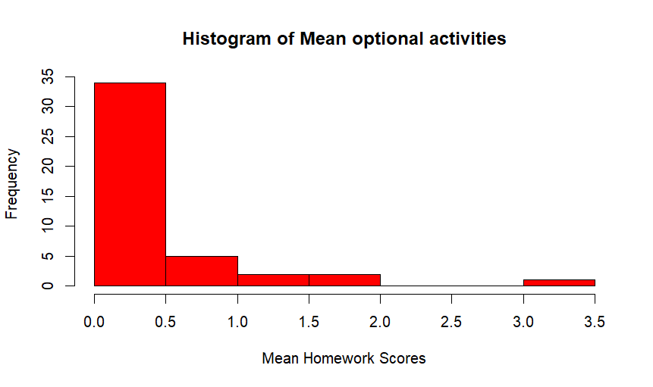
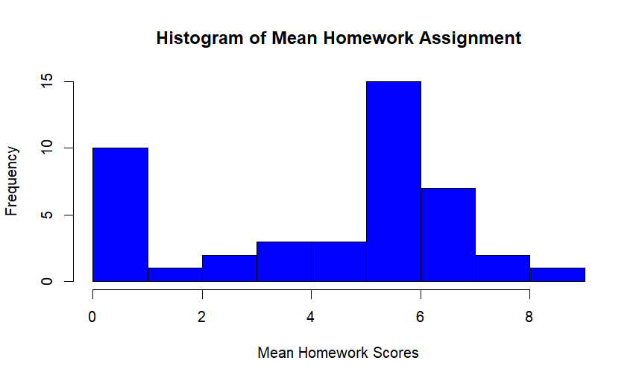
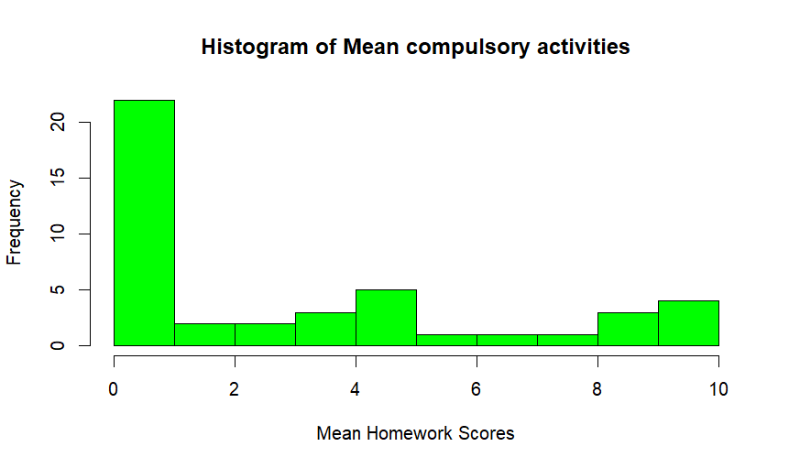
Cleaning data

Slide 6
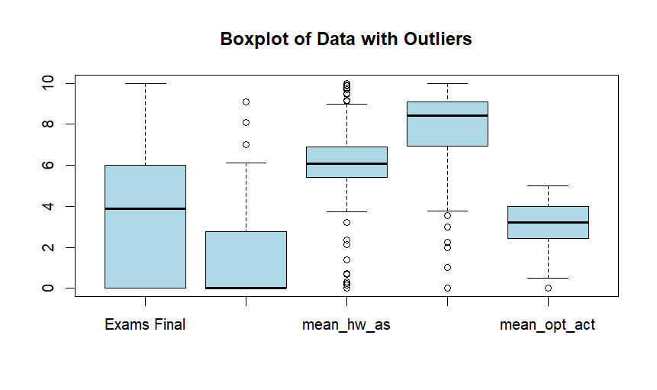
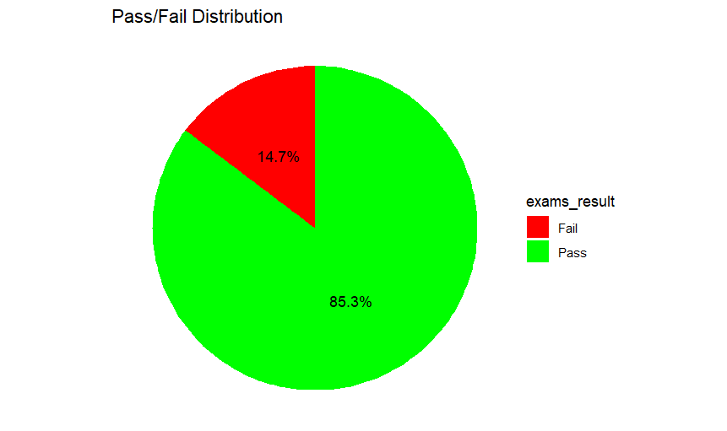
Cleaning data

Slide 7
Cleaning data
Created new dataframe excluding those who did not participate in the final exams
Found the outliers and deleted them
Labeled the outcomes for predictions(pass-fail, or grade categories(good, very good, excellent)

Slide 8
Exploratory Data Analysis (EDA)
Key steps in EDA:
Grade Distribution Analysis
PCA(for the significance order of our variables)
Covariance Analysis (Homework, Compulsory Activities, Optional Activities and Exams) The covariance between final grades and the other variables is positive which suggests that as assignment scores increase, final grades tend to increase as well.
The correlation between Final Grade and assignments is positive but not so strong (0,38 with Assignments, 0,15 with Compulsory activities, 0,42 with Optional Activities) which indicates a weak to moderate positive relationship

Slide 9
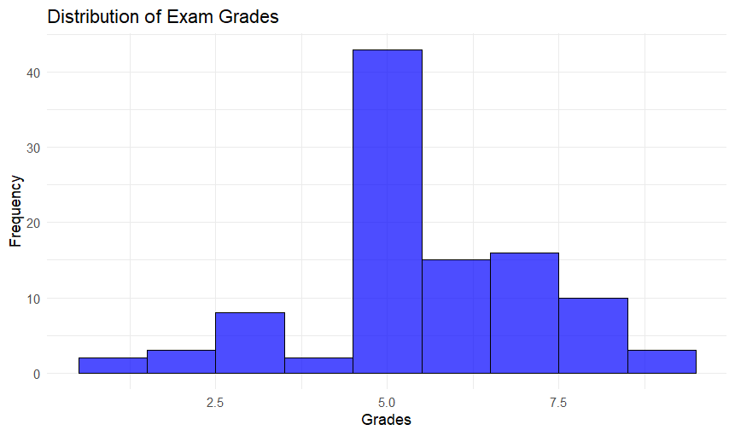
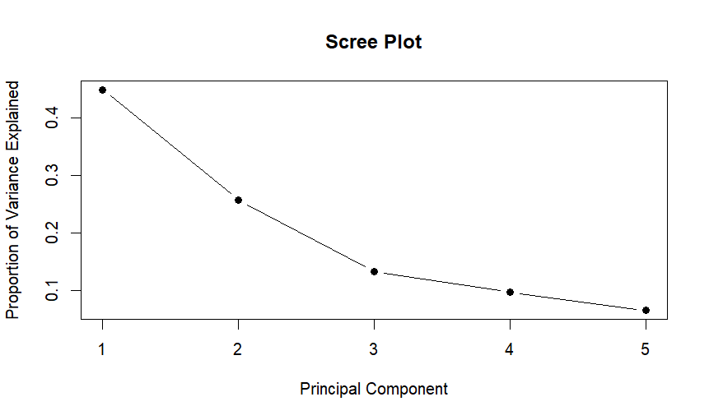
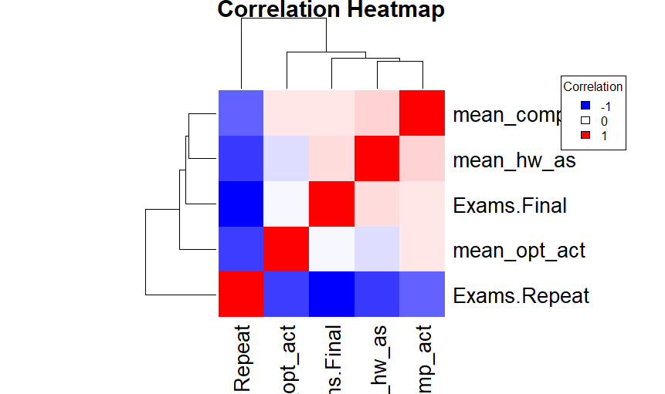

Slide 10
Predictive Modeling Approach
Steps taken for prediction:
Data Preprocessing (scaling and standarlizing)
Linear Regression Model(single and multiple) for Exam Prediction
Support Vector Machines also for Exam Prediction
Hypothesis testing
Naive Bayes
(All the above indicated a positive relationship between the extra activities and the final grade)

Slide 11
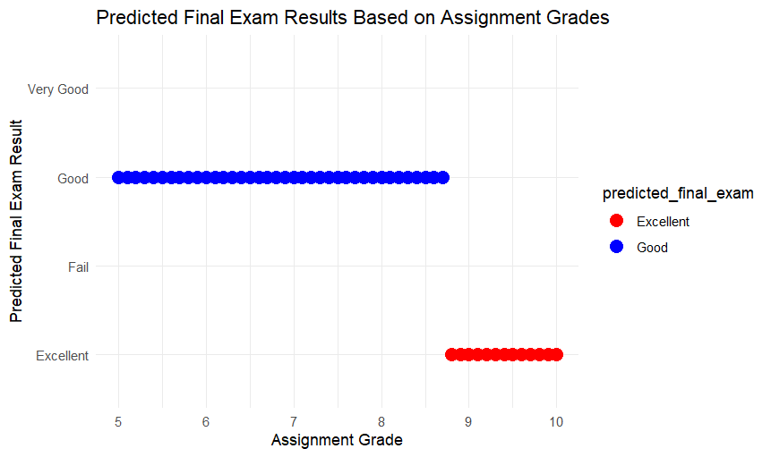
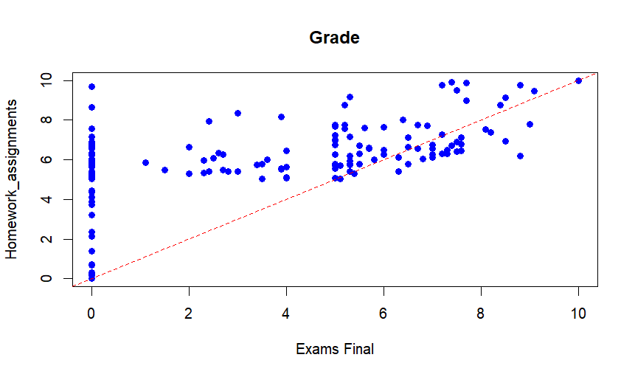

Slide 12
Clustering Students
Used k-means clustering and hierarchical to identify groups:
High Performers
Moderate Performers
Low Performers
This helps tailor educational interventions.

Slide 13
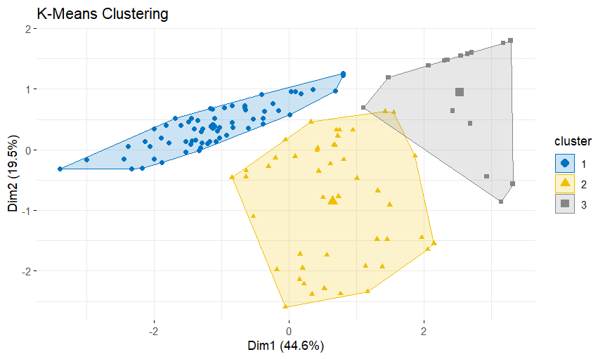
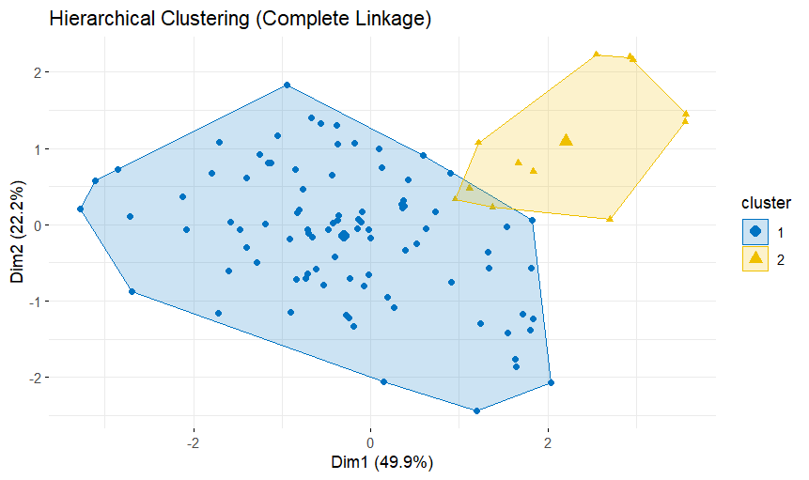
Clustering Students

Slide 14
Results and Insights
- Homework & Compulsory grades strongly correlate with exam performance.
- The statistically significant correlation (p-value < 0.05) confirms that assignment performance influences final grades.
- Non-participation is a key indicator of poor performance.
- Identified clusters can help educators target at-risk students.

Slide 15
Conclusion & Recommendations
- Regularly monitor student grades and participation.
- Provide extra support for low-performing students.
- Encourage engagement through optional activities.
Provide targeted interventions for students at risk of failing
- Explore additional factors like attendance and study hours and habits for better predictions.

